Slide 1


YouTube songs analysis
By / Mariam Hossam

Slide 2



Problem Statement
This internship project aims to conduct a comprehensive analysis of YouTube songs data using Power BI. The dataset contains key attributes such as video ID, channel title, title, description, tags, published date, view count, like count, favorite count, comment count, video duration, video definition, and caption details. The goal is to utilize Power BI to create insightful visualizations and reports that provide a deeper understanding of YouTube songs' performance, popularity, and user engagement. The analysis aims to uncover trends, preferences, and patterns in the data to aid content creators and stakeholders in optimizing their YouTube song content

Slide 3
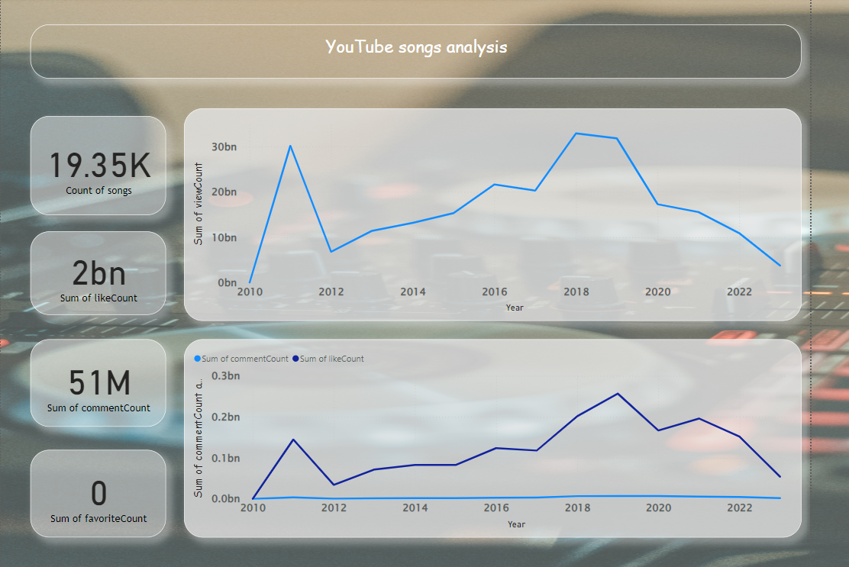
Question #3
G__d M_r_i_g
Hint: Song of the Year

Slide 4
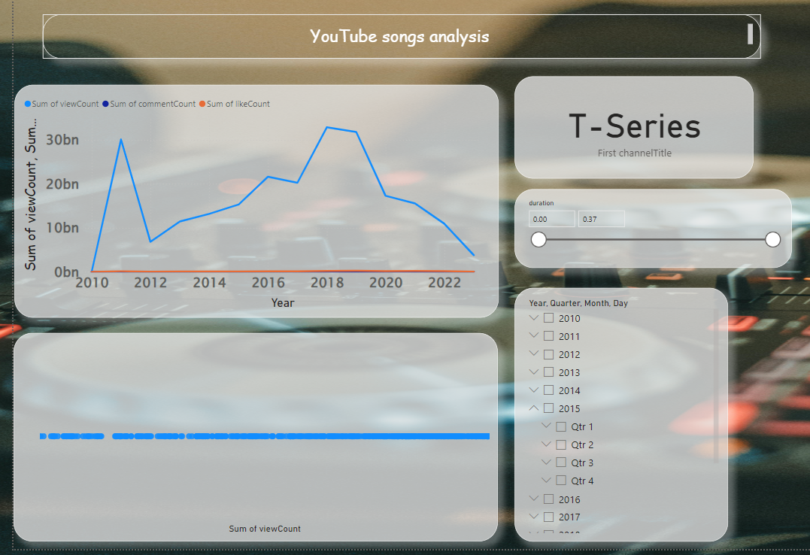
Heading
Subheading
Body

Slide 5
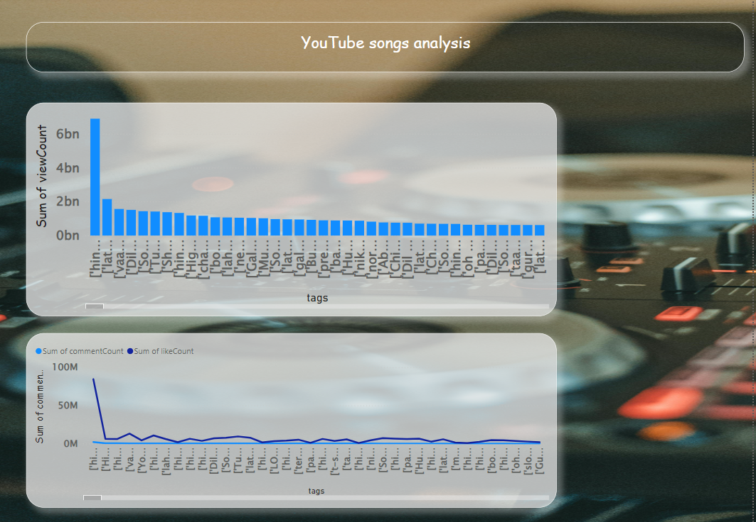
Heading
Subheading
Body

Slide 6
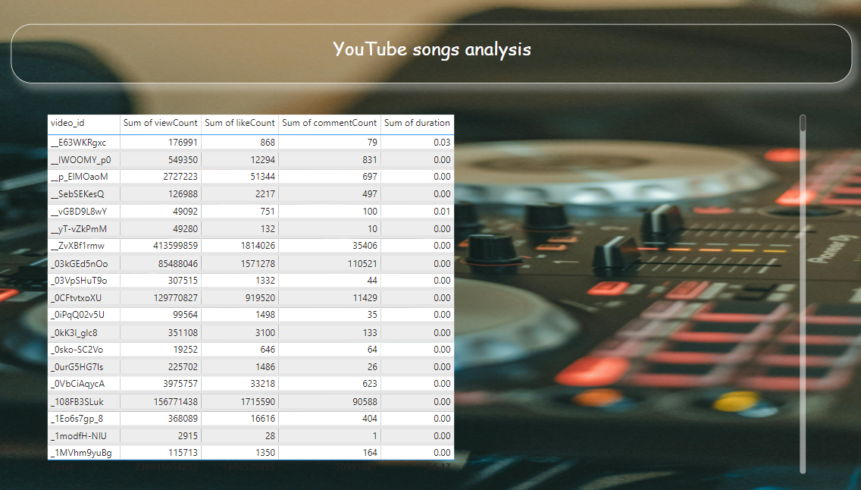
Answer #1
Sweet Night

Slide 7
Recommandation
We can use special hashtags related to famous hashtags to make
to increase view count.
Put less ads on the videos so the people can watch with more duration.
Make options for videos quality than hd to enable less usage for data.
Use reels for short songs.
Put Videos from series or a famous movies on the reels
Optimize titles & descriptions with keywords.
Engage viewers through comments and discussions.
Use relevant tags for search visibility.
Promote videos on social media.
Maintain a consistent posting schedule.
Create appealing thumbnails.
Collaborate with other creators.
Analyze metrics regularly.
Utilize playlists to increase watch time.

Slide 8

Thanks !

